Slide 1

Data Structures and Abstractions with Java™
5th Edition
Module 0
Review

Slide 2
Topics for Review
Object Oriented Programming
Abstraction
Interfaces
Javadoc, Junit tests
UML

Slide 3
Object Oriented Programming
Encapsulation
Inheritance
Polymorphism

Slide 4
Encapsulation
Information hiding
Enclose data and methods within a class
Hide implementation details
Programmer receives only enough information to be able to use the class

Slide 5
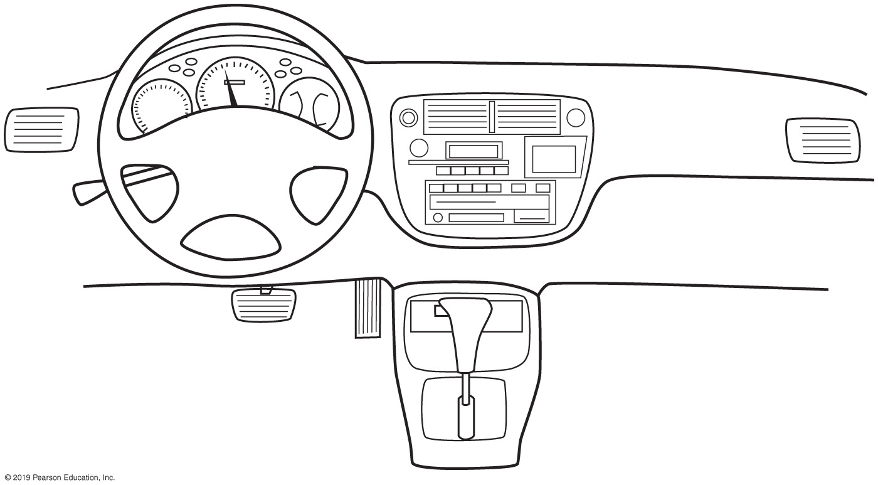
Encapsulation
FIGURE P-1 An automobile’s controls are visible to the driver, but its inner workings are hidden

Slide 6
Abstraction
Focus on what instead of how
What needs to be done?
For the moment ignore how it will be done.
Divide class into two parts
Client interface
Implementation

Slide 7
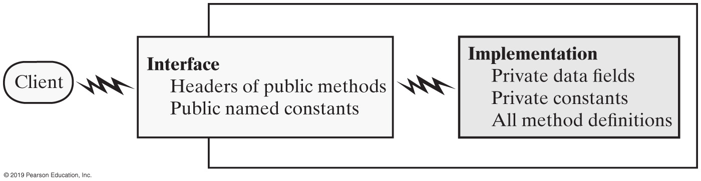
Abstraction
FIGURE P-2 An interface provides well-regulated communication between a hidden implementation and a client

Slide 8
Specifying Methods
Preconditions
What must be true before method executes
Implies responsibility for client
Postconditions
Statement of what is true after method executes
Use assertions
In comments or with assert statement

Slide 9
Java Interfaces
Program component that declares a number of public methods
Should include comments to inform programmer
Any data fields here should be public, final, static

Slide 10
Interface Measurable
/**
An interface for methods that return
the perimeter and area of an object.
*/
public interface Measurable
{
/** Gets the perimeter.
@return The perimeter. */
public double getPerimeter();
/** Gets the area.
@return The area. */
public double getArea();
} // end Measurable
Listing 2-1

Slide 11
Interface NameMeasurable
/** An interface for a class of names. */
public interface NameInterface
{
/** Sets the first and last names.
@param firstName A string that is the desired first name.
@param lastName A string that is the desired last name. */
public void setName(String firstName, String lastName);
/** Gets the full name.
@return A string containing the first and last names. */
public String getName();
public void setFirst(String firstName);
public String getFirst();
public void setLast(String lastName);
public String getLast();
public void giveLastNameTo(NameInterface aName);
public String toString();
} // end NameInterface
Listing 2-2

Slide 12
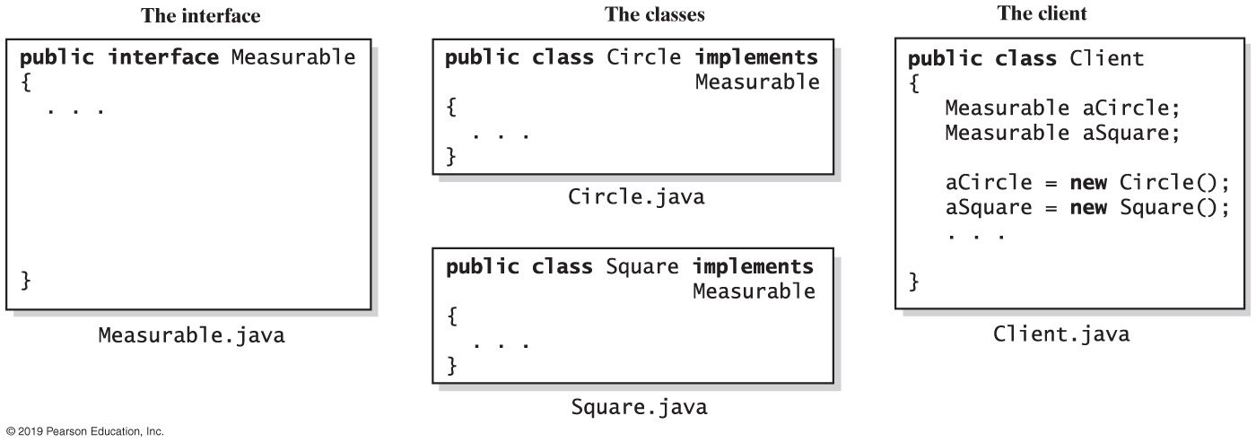
Implementing an Interface
FIGURE P-3 The files for an interface, a class that implements the interface, and the client

Slide 13
Implementing an Interface
A way for programmer to guarantee a class has certain methods
Several classes can implement the same interface
A class can implement more than one interface

Slide 14
Interface as a Data Type
You can use a Java interface as you would a data type
Indicates variable can invoke certain set of methods and only those methods.
An interface type is a reference type
An interface can be used to derive another interface by using inheritance

Slide 15
Interface vs. Abstract Class
Purpose of interface similar to that of abstract class
But an interface is not a class
Use an abstract class …
If you want to provide a method definition
Or declare a private data field that your classes will have in common
A class can implement several interfaces but can extend only one abstract class.

Slide 16
Named Constants Within an Interface
An interface can contain named constants,
Public data fields that you initialize and declare as final.
Options:
Define the constants in an interface that the classes implement
Define your constants in a separate class instead of an interface

Slide 17
- Documenting and Testing Tools
Javadoc
JUnit Test
- Exceptions
Throwing exceptions
Checked and Unchecked Exceptions
Catching exceptions
finally clause
Designing your own exceptions

Slide 18
Commenting the Public Interface – using Javadoc
comes with Java JDK
automatically generate documentation for the classes, interfaces, and methods
produces HTML documentation with the same structure as the Java API documentation.
To generate this documentation, there are two general steps necessary:
Write documentation comments in the Java source code file
Run the javadoc utility

Slide 19
Commenting the Public Interface – using Javadoc
Class Comment
/**
A bank account has a balance that can be
changed by deposits and withdrawals.
*/
public class BankAccount
{
. . .
}
Provide documentation comments for
every class
every method
every parameter
every return value

Slide 20
Commenting the Public Interface – using javadoc
Javadoc tags
@author AuthorName class
@version VersionNumber class
@throws ExceptionName Description class
@param parameterName Description method
@return Description method
@exception ExceptionName Description method
@serial Description method
@serialData Description method
@serialField Name Type Description method
We will be using
These later

Slide 21
Commenting the Public Interface – using javadoc
Method Comments
/** Withdraws money from the bank account. @param amount the amount to withdraw */ public void withdraw(double amount) { //implementation filled in later } /** Gets the current balance of the bank account. @return the current balance */ public double getBalance() { //implementation filled in later }

Slide 22
/**
A bank account has a balance that can be changed by
deposits and withdrawals.
@author Professor Myers
*/
public class BankAccount {
/** the balance of the Bank Account
*/
private int balance;
// Constructors
/** Constructs a Bank Account with balance set to 0
*/
public BankAccount()
{
// body--filled in later
}
/** Constructs a Bank Account with the balance set to initialBalance
* @param initialBalance
*/
public BankAccount(double initialBalance)
{
// body--filled in later
}
/** Withdraws money from the bank account.
@param amount the amount to withdraw
*/
public void withdraw(double amount)
{
//implementation filled in later
}
/** Gets the current balance of the bank account.
@return the current balance
*/
public double getBalance()
{
//implementation filled in later
}
/** sets balance to 0
*/
public void reset()
{
balance = 0;
}
}
Javadoc tags
Javadoc comments

Slide 23
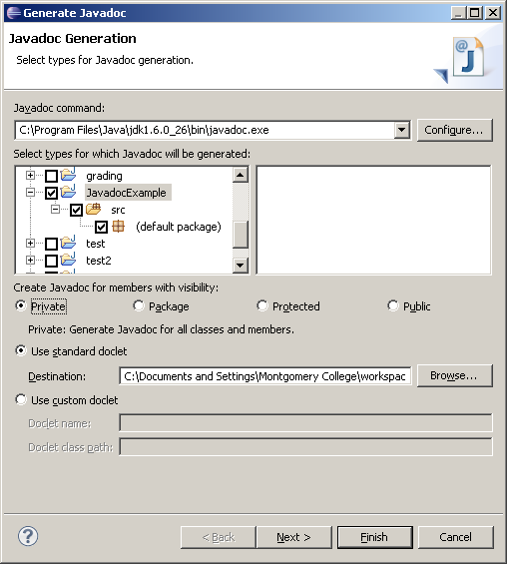
Generating Javadoc in Eclipse
Find where the javadoc.exe
exists on your computer. It
will be in the bin folder of
your jdk. Put the pathname
here.
1. Under Project, Select “Generate Javadoc”
Select the project you want
to generate the javadoc for
Select private so that
private fields will show
up in documentation
Choose the folder
where the javadoc will be
stored
Use the standard
doclet
Select Finish

Slide 24
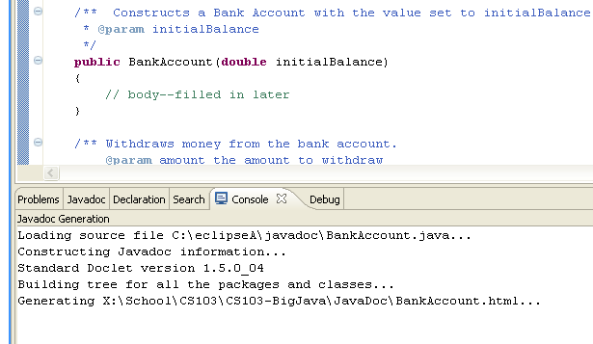
Generating Javadoc in Eclipse
In the Console window you will
see the javadoc files being
generated

Slide 25
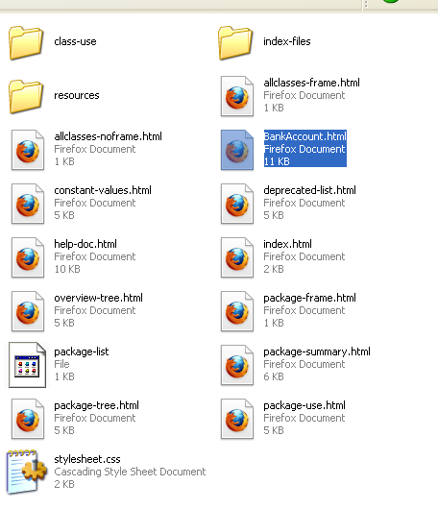
Generating Javadoc in Eclipse
Open the folder where the javadoc
was placed. Open the.html for your class

Slide 26
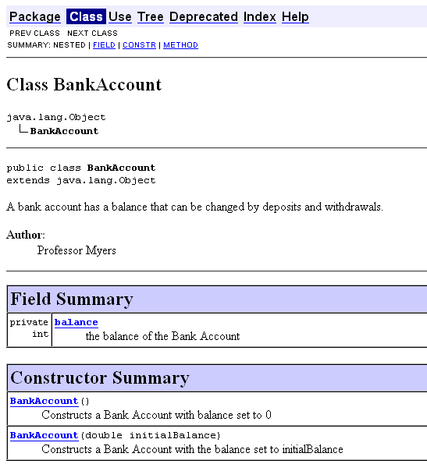
Field Summary is only
generated if private was
selected

Slide 27
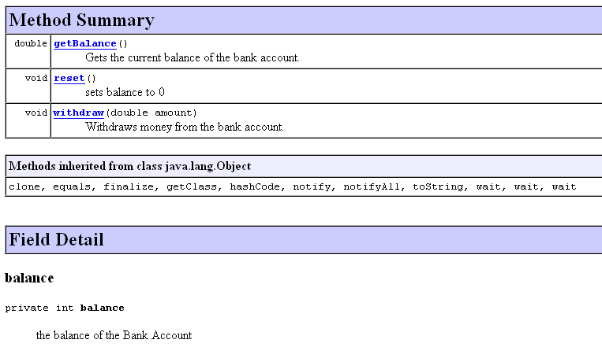

Slide 28
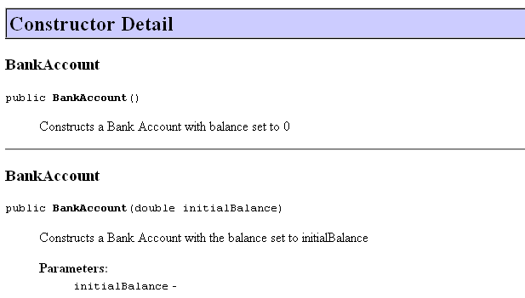
Notice no description for initialBalance
/** Constructs a Bank Account with the balance set to initialBalance
* @param initialBalance
*/
public BankAccount(double initialBalance)
{
// body--filled in later
}

Slide 29
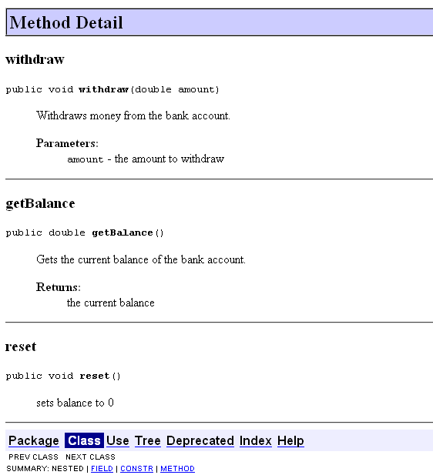
Notice there is a description for amount
/** Withdraws money from the bank account.
@param amount the amount to withdraw
*/
public void withdraw(double amount)
{
//implementation filled in later
}

Slide 30
Unit Testing Frameworks
Unit test frameworks simplify the task of writing classes that contain many test cases
JUnit: http://junit.org
Built into some IDEs like BlueJ and Eclipse
Philosophy: whenever you implement a class, also make a companion test class. Run all tests whenever you change your code
Customary that name of the test class ends in Test
The test class that test the BankAccount class would be called BankAccountTest
We will be using JUnit 4 test (easier than JUnit 3 test)
To test the file – it must be fully implemented

Slide 31

My program works!
(I’m not really sure why)

Slide 32
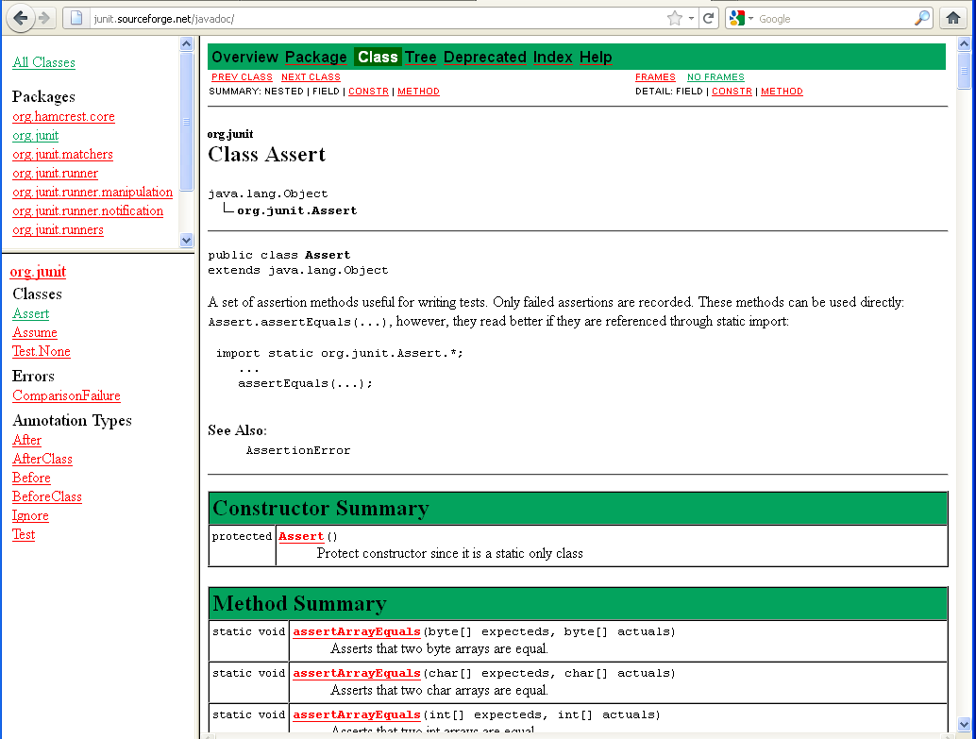
http://junit.sourceforge.net/javadoc/

Slide 33
JUnit provides overloaded assertion methods for all primitive types and Objects and arrays (of primitives or Objects). The parameter order is expected value followed by actual value.
assertEquals(true, “hello”.equals(“hello”);
assertEquals(“hello”, “hello”);
assertEquals(false, “hello”.equals(“goodbye”);
assertTrue(“hello”.equals(“hello”);
assertFalse(“hello”.equals(“goodbye”);
Optionally the first parameter can be a String message that is output on failure.
assertEquals(“failure – strings should be equal”, true, “hello”.equals(“hello”);
assertEquals(“failure – strings should be equal”, “hello”, “hello”);

Slide 34
When comparing numerics, put in a third parameter which indicates
The amount of precision you would consider two numbers to be “equal”
assertEquals(25.55, employee1.getPayrate(), .001);
This means that if the results of (getPayrate() – 25.55) < .001,
It is considered equal.

Slide 35
/**
A bank account has a balance that can be changed by
deposits and withdrawals.
@author Professor Myers
*/
public class BankAccount {
/** the balance of the Bank Account
*/
private double balance;
// Constructors
/** Constructs a Bank Account with balance set to 0
*/
public BankAccount()
{
balance = 0;
}
/** Constructs a Bank Account with the balance set to initialBalance
* @param initialBalance
*/
public BankAccount(double initialBalance)
{
balance = initialBalance;
}
/** Withdraws money from the bank account.
@param amount the amount to withdraw
*/
public void withdraw(double amount)
{
balance -= amount;
}
/** Gets the current balance of the bank account.
@return the current balance
*/
public double getBalance()
{
return balance;
}
/** sets balance to 0
*/
public void reset()
{
balance = 0;
}
}
Methods have been
implemented

Slide 36
JUnit Test in Eclipse
Right click on the file that contains the class you want to create a test class for.
Select New
Select JUnit Test Case

Slide 37
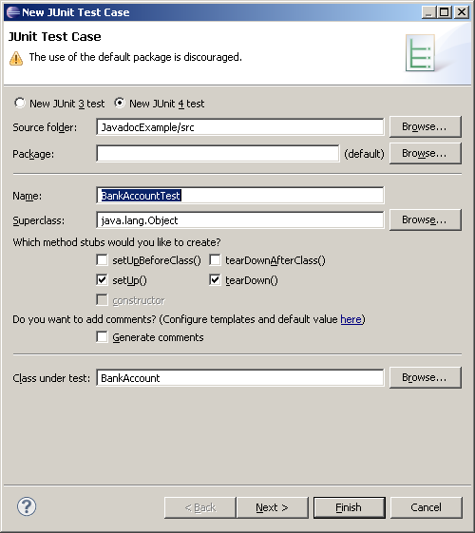
JUnit 4 Test in Eclipse
Select JUnit 4
Automatically puts
In name of class +
Test
These are defaults –
keep them
If this isn’t the class
you want a test for –
select Browse
Select Next

Slide 38
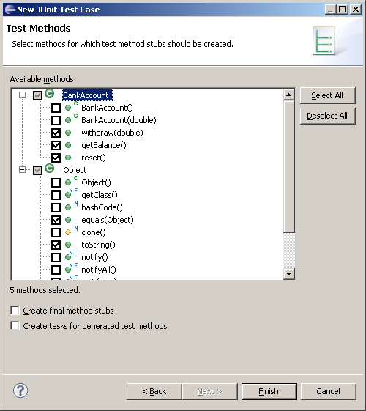
JUnit 4 Test in Eclipse
Select all the
methods that you
want a test for
Select Finish

Slide 39
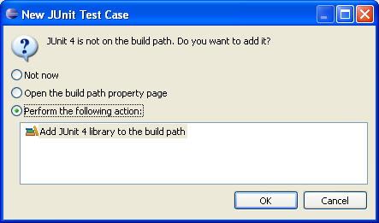
JUnit 4 Test in Eclipse
This will appear the first time you add a JUnit 4 test to a project

Slide 40
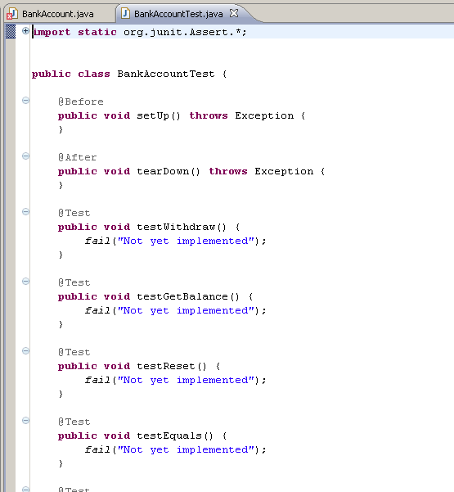
JUnit 4 Test in Eclipse
Creates a test file

Slide 41
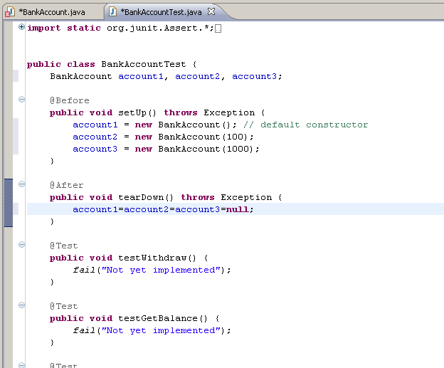
JUnit 4 Test in Eclipse
First create
objects that
can be used
for the tests
This method will
deallocate objects
after each test
setUp is executed before each test method
tearDown is executed after each test method

Slide 42
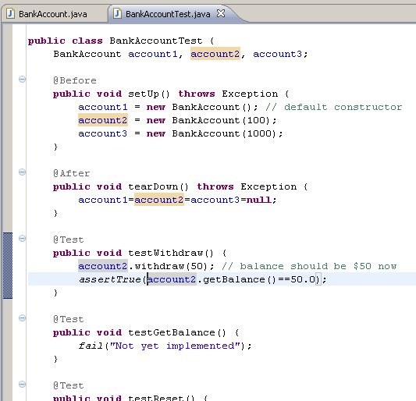
JUnit 4 Test in Eclipse
Implement a test

Slide 43
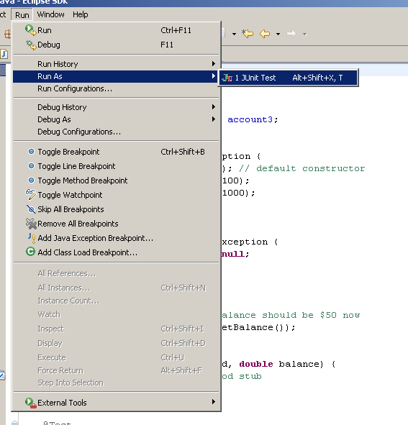
JUnit 4 Test in Eclipse

Slide 44
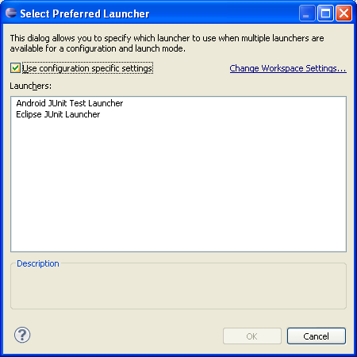
If you see this pop-up, select Eclipse Junit Launcher

Slide 45
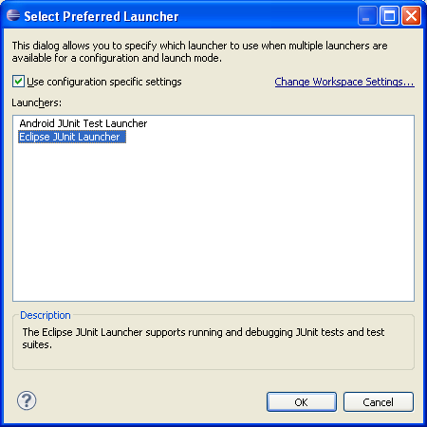
Select OK

Slide 46
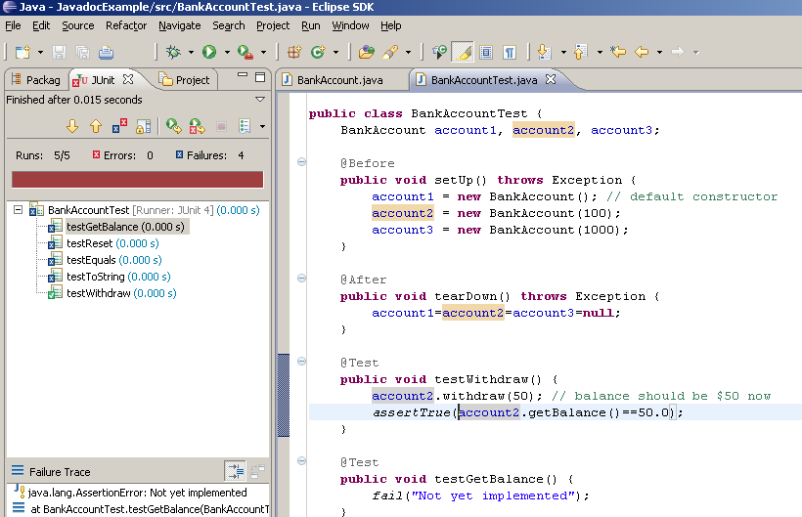
JUnit 4 Test in Eclipse
The test was successful

Slide 47
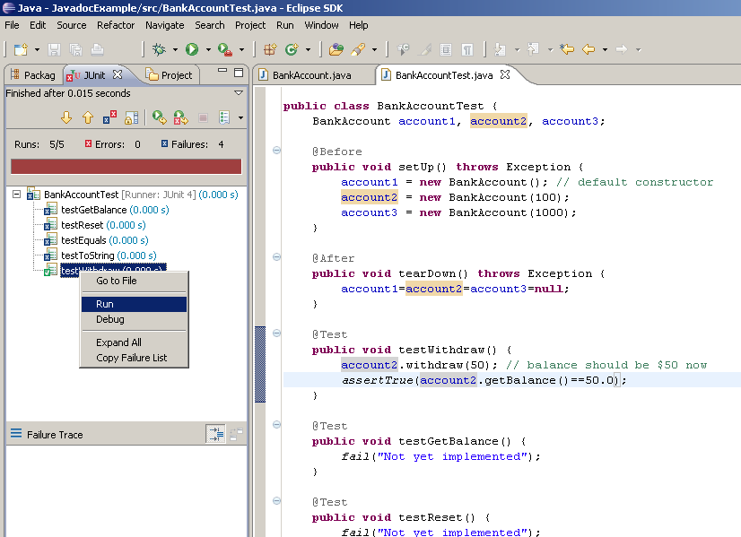
JUnit 4 Test in Eclipse
Right click on the test to run just that test

Slide 48
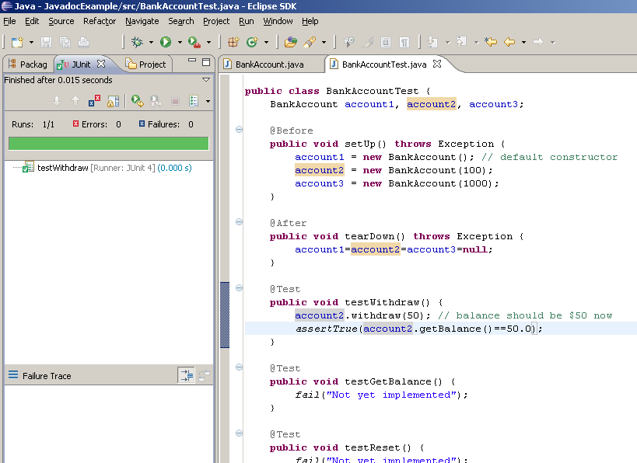
JUnit 4 Test in Eclipse
The test was successful

Slide 49
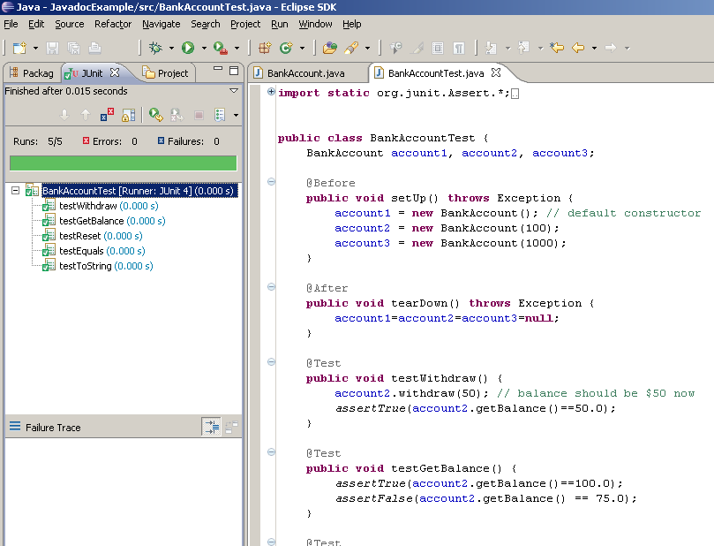
JUnit 4 Test in Eclipse
Continue until
All tests are complete
And successful

Slide 50
Guidelines for JUnit Tests
Your test methods should test the method with at least 2 or 3 objects.
Example:
@Test
public void testEquals() {
assertFalse(book1.equals(book2));
assertTrue(book1.equals(book3));
}
If you are using an assertEquals, the first argument is what you expect the
result to be, the second argument is the call to the method
assertEquals(15.99, book2.getPrice(), .001);
If the method changes one of the data members of the object, test what the value of the data member is first, call the method and then test the new value of the data member.
Example:
@Test
public void testSetPrice() {
assertEquals(15.99, book2.getPrice(), .001); // test current price
book2.setPrice(16.99); //change the value of price
assertEquals(16.99, book2.getPrice(), .001); // test new value
}

Slide 51
Guidelines for JUnit Tests
You should not assume that tests will be called in any particular order. There is no guarantee that testEquals will execute before testSetPrice.
@Test
public void testEquals() {
. . .
}
@Test
public void testSetPrice() {
. . .
}
Keep tests in the same location as the source code
If the test source is kept in the same location as the tested classes, both test and class will compile during a build.
Name tests properly
Example:
public void testSetPrice()
public void testGetPrice()
public void testEquals()

Slide 52
Unified Modeling Language Class
CourseSchedule
courseCount courseList
addCourse(course) removeCourse(course) isTimeConflict() listSchedule()
FIGURE P-7 A class representation that can be a part of a class diagram

Slide 53
UML Interface Example
<<interface>> Measurable
+getPerimeter(): double +getArea(): double
FIGURE P-8 UML notation for the interface Measurable

Slide 54
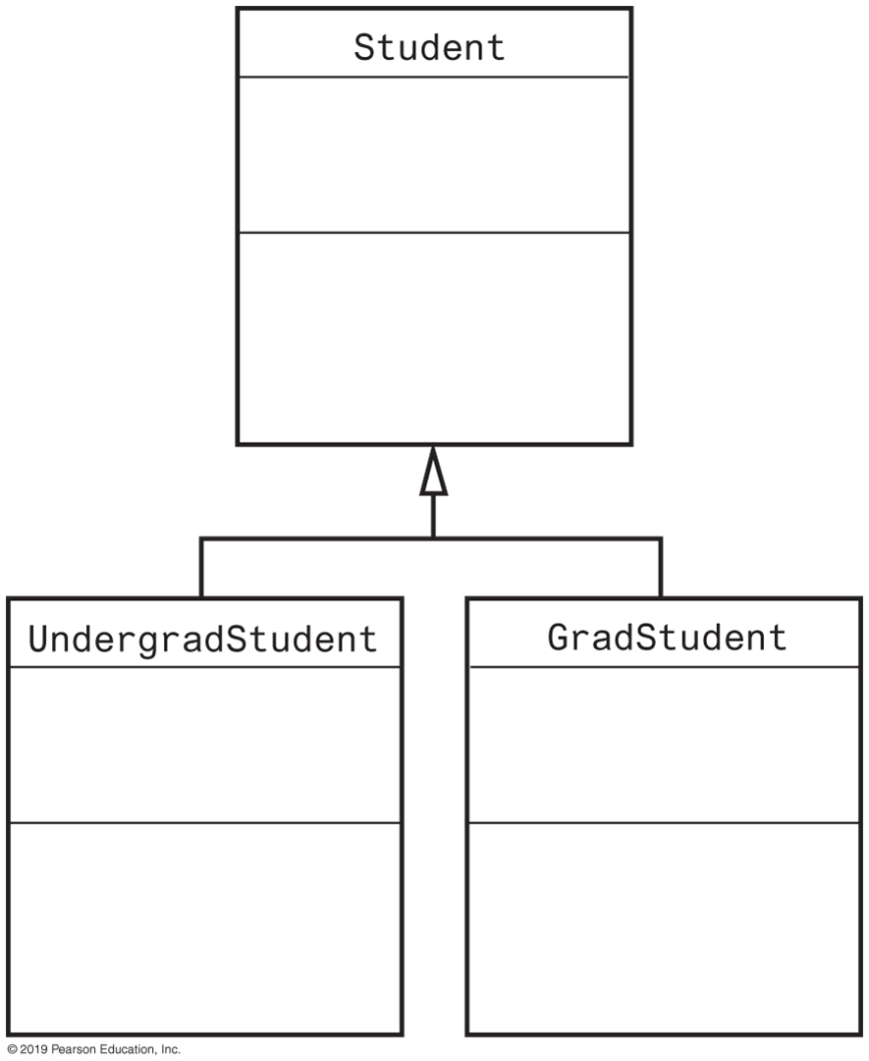
UML Class Hierarchy
FIGURE P-9 A class diagram showing the base class Student and two subclasses

Slide 55
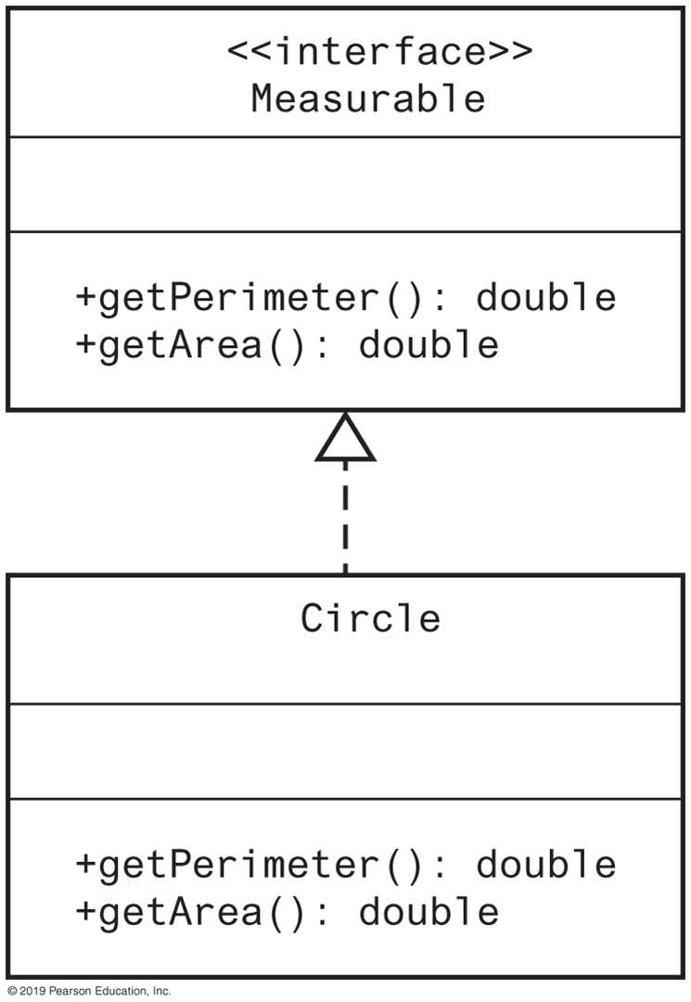
UML Interface Implementation
FIGURE P-10 A class diagram showing the class Circle that implements the interface Measurable

Slide 56
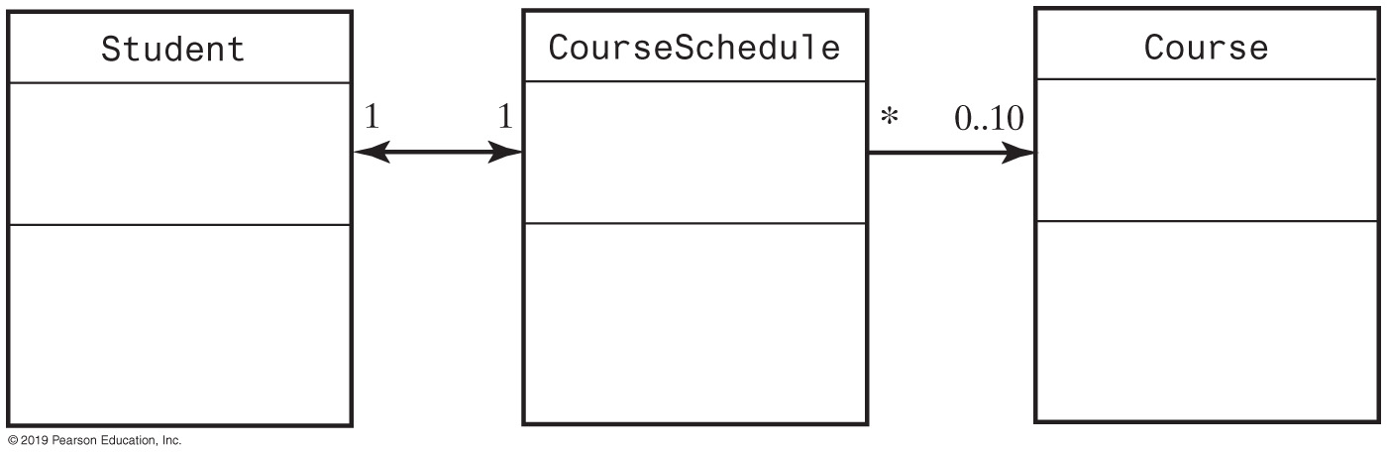
UML Class Associations
FIGURE P-11 Part of a UML class diagram with associations

